Slide 1

Networks & Security Lecture-3
www.corvit.com

Slide 2
Topics
Transport Layer
Multiplexing/demultiplexing
UDP
TCP
www.corvit.com

Slide 3

















Transport Services And Protocols
provide logical communication between app processes running on different hosts
transport protocols run in end systems
send side: breaks app messages into segments, passes to network layer
rcv side: reassembles segments into messages, passes to app layer
more than one transport protocol available to apps
Internet: TCP and UDP
application
transport
network
data link
physical
logical end-end transport
application
transport
network
data link
physical
www.corvit.com

Slide 4
Transport vs. Network Layer
network layer: logical communication between hosts
transport layer: logical communication between processes
relies on, enhances, network layer services
household analogy:
12 kids in Ann’s house sending letters to 12 kids in Bill’s house:
hosts = houses
processes = kids
app messages = letters in envelopes
transport protocol = Ann and Bill who demux to in-house siblings
network-layer protocol = postal service
www.corvit.com

Slide 5
Internet Transport-Layer Protocols
reliable, in-order delivery (TCP)
congestion control
flow control
connection setup
unreliable, unordered delivery: UDP
no-frills extension of “best-effort” IP
services not available:
delay guarantees
bandwidth guarantees
application
transport
network
data link
physical
network
data link
physical
network
data link
physical
network
data link
physical
logical end-end transport
network
data link
physical
network
data link
physical
network
data link
physical
network
data link
physical
application
transport
network
data link
physical
www.corvit.com

Slide 6

Multiplexing / Demultiplexing
multiplexing at sender:
handle data from multiple
sockets, add transport header (later used for demultiplexing)
demultiplexing at receiver:
use header info to deliver
received segments to correct
socket
application
application
P1
P2
application
socket
P3
transport
P4
process
transport
network
transport
network
link
network
link
physical
link
physical
physical
www.corvit.com

Slide 7
How Demultiplexing Works
32 bits
host receives IP datagrams
each datagram has source IP address, destination IP address
each datagram carries one transport-layer segment
each segment has source, destination port number
host uses IP addresses & port numbers to direct segment to appropriate socket
source port #
dest port #
other header fields
application
data
(payload)
TCP/UDP segment format
www.corvit.com

Slide 8
Connectionless Demultiplexing
recall: when creating datagram to send into UDP socket, must specify
destination IP address
destination port #
recall: created socket has host-local port #:
DatagramSocket mySocket1 = new DatagramSocket(12534);
when host receives UDP segment:
checks destination port # in segment
directs UDP segment to socket with that port #
IP datagrams with same dest. port #, but different source IP addresses and/or source port numbers will be directed to same socket at dest
www.corvit.com

Slide 9
Connectionless Demux: Example
DatagramSocket serverSocket = new DatagramSocket
(6428);
DatagramSocket mySocket2 = new DatagramSocket
(9157);
DatagramSocket mySocket1 = new DatagramSocket (5775);
application
application
P1
application
P3
P4
transport
transport
network
transport
network
link
network
link
physical
link
physical
physical
source port: 6428
dest port: 9157
source port: ?
dest port: ?
source port: 9157
dest port: 6428
source port: ?
dest port: ?
www.corvit.com

Slide 10
Connection-Oriented Demux
TCP socket identified by 4-tuple:
source IP address
source port number
dest IP address
dest port number
demux: receiver uses all four values to direct segment to appropriate socket
server host may support many simultaneous TCP sockets:
each socket identified by its own 4-tuple
web servers have different sockets for each connecting client
non-persistent HTTP will have different socket for each request
www.corvit.com

Slide 11
Connection-Oriented Demux: Example
application
application
P4
P5
P6
application
P3
P2
P3
transport
transport
network
transport
network
link
network
link
physical
link
physical
server: IP address B
physical
host: IP address A
source IP,port: B,80
dest IP,port: A,9157
host: IP address C
source IP,port: C,5775
dest IP,port: B,80
source IP,port: A,9157
dest IP, port: B,80
source IP,port: C,9157
dest IP,port: B,80
three segments, all destined to IP address: B,
dest port: 80 are demultiplexed to different sockets
www.corvit.com

Slide 12
Connection-Oriented Demux: Example
threaded server
application
application
application
P4
P3
P3
P2
transport
transport
network
transport
network
link
network
link
physical
link
physical
server: IP address B
physical
host: IP address A
source IP,port: B,80
dest IP,port: A,9157
host: IP address C
source IP,port: C,5775
dest IP,port: B,80
source IP,port: A,9157
dest IP, port: B,80
source IP,port: C,9157
dest IP,port: B,80
www.corvit.com

Slide 13
UDP: User Datagram Protocol [RFC 768]
“no frills,” “bare bones” Internet transport protocol
“best effort” service, UDP segments may be:
lost
delivered out-of-order to app
connectionless:
no handshaking between UDP sender, receiver
each UDP segment handled independently of others
UDP use:
streaming multimedia apps (loss tolerant, rate sensitive)
DNS
SNMP
reliable transfer over UDP:
add reliability at application layer
application-specific error recovery!
www.corvit.com

Slide 14
UDP: Segment Header
length, in bytes of UDP segment, including header
32 bits
source port #
dest port #
length
checksum
why is there a UDP?
no connection establishment (which can add delay)
simple: no connection state at sender, receiver
small header size
no congestion control: UDP can blast away as fast as desired
application
data
(payload)
UDP segment format
www.corvit.com

Slide 15
UDP Checksum
Goal: detect “errors” (e.g., flipped bits) in transmitted segment
Sender:
treat segment contents, including header fields, as sequence of 16-bit integers
checksum: addition (one’s complement sum) of segment contents
sender puts checksum value into UDP checksum field
Receiver:
compute checksum of received segment
check if computed checksum equals checksum field value:
NO - error detected
YES - no error detected. But maybe errors nonetheless? More later ….
www.corvit.com

Slide 16
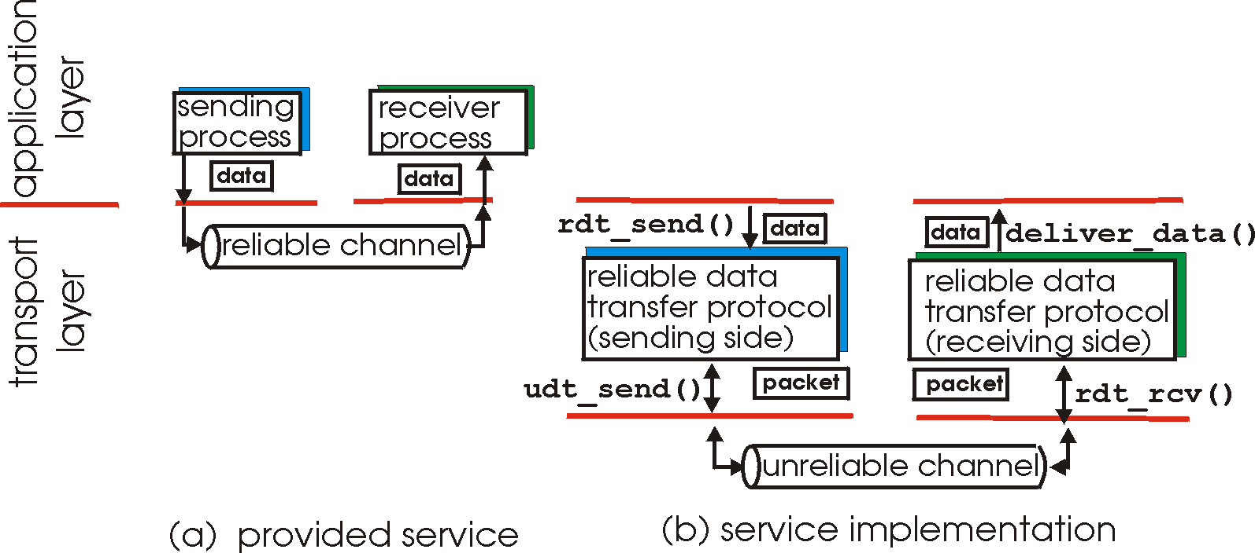
Principles Of Reliable Data Transfer
important in application, transport, link layers
top-10 list of important networking topics!
characteristics of unreliable channel will determine complexity of reliable data transfer protocol (rdt)
www.corvit.com

Slide 17
Principles Of Reliable Data Transfer
important in application, transport, link layers
top-10 list of important networking topics!
characteristics of unreliable channel will determine complexity of reliable data transfer protocol (rdt)
www.corvit.com

Slide 18
Principles Of Reliable Data Transfer
important in application, transport, link layers
top-10 list of important networking topics!
characteristics of unreliable channel will determine complexity of reliable data transfer protocol (rdt)
www.corvit.com

Slide 19
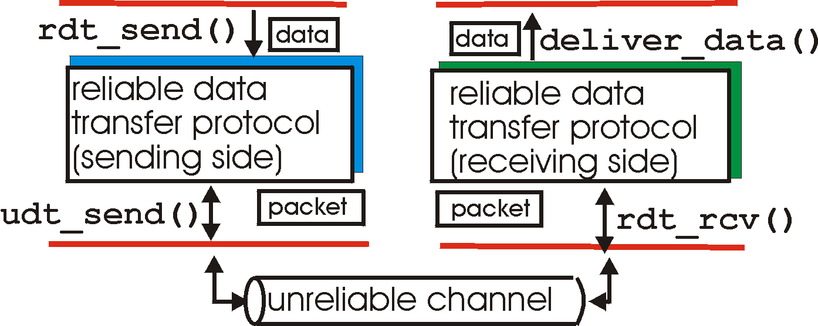
Reliable Data Transfer: Getting Started
rdt_send(): called from above, (e.g., by app.). Passed data to
deliver to receiver upper layer
deliver_data(): called by rdt to deliver data to upper
send
side
receive
side
udt_send(): called by rdt,
to transfer packet over
unreliable channel to receiver
rdt_rcv(): called when packet arrives on rcv-side of channel
www.corvit.com

Slide 20
Reliable Data Transfer: Getting Started
we’ll:
incrementally develop sender, receiver sides of reliable data transfer protocol (rdt)
consider only unidirectional data transfer
but control info will flow on both directions!
use finite state machines (FSM) to specify sender, receiver
event causing state transition
actions taken on state transition
state: when in this “state” next state uniquely determined by next event
state
1
state
2
event
actions
www.corvit.com

Slide 21
rdt1.0: Reliable Transfer Over A Reliable Channel
underlying channel perfectly reliable
no bit errors
no loss of packets
separate FSMs for sender, receiver:
sender sends data into underlying channel
receiver reads data from underlying channel
Wait for call from above
rdt_send(data)
Wait for call from below
rdt_rcv(packet)
extract (packet,data)
deliver_data(data)
packet = make_pkt(data)
udt_send(packet)
sender
receiver
www.corvit.com

Slide 22
TCP: Overview RFCs: 793,1122,1323, 2018, 2581
point-to-point:
one sender, one receiver
reliable, in-order byte steam:
no “message boundaries”
pipelined:
TCP congestion and flow control set window size
full duplex data:
bi-directional data flow in same connection
MSS: maximum segment size
connection-oriented:
handshaking (exchange of control msgs) inits sender, receiver state before data exchange
flow controlled:
sender will not overwhelm receiver
www.corvit.com

Slide 23
TCP Segment Structure
32 bits
URG: urgent data
(generally not used)
counting
by bytes
of data
(not segments!)
source port #
dest port #
sequence number
ACK: ACK #
valid
acknowledgement #
head
len
not
used
U
receive window
A
PSH: push data now
(generally not used)
P
R
S
F
# bytes
rcvr willing
to accept
checksum
Urg data pointer
RST, SYN, FIN:
connection estab
(setup, teardown
commands)
options (variable length)
application
data
(variable length)
Internet
checksum
(as in UDP)
www.corvit.com

Slide 24
TCP Seq. Numbers, ACKs
outgoing segment from sender
sequence numbers:
byte stream “number” of first byte in segment’s data
acknowledgements:
seq # of next byte expected from other side
cumulative ACK
Q: how receiver handles out-of-order segments
A: TCP spec doesn’t say, - up to implementor
source port #
dest port #
sequence number
acknowledgement number
rwnd
checksum
urg pointer
window size
N
sender sequence number space
sent
ACKed
sent, not-yet ACKed
(“in-flight”)
usable
but not
yet sent
not
usable
incoming segment to sender
source port #
dest port #
sequence number
A
acknowledgement number
rwnd
checksum
urg pointer
www.corvit.com

Slide 25
TCP Seq. Numbers, ACKs
Host A
Host B
User
types
‘C’
Seq=42, ACK=79, data = ‘C’
host ACKs
receipt of
‘C’, echoes
back ‘C’
Seq=79, ACK=43, data = ‘C’
host ACKs
receipt
of echoed
‘C’
Seq=43, ACK=80
simple telnet scenario
www.corvit.com

Slide 26
TCP Reliable Data Transfer
TCP creates rdt service on top of IP’s unreliable service
pipelined segments
cumulative acks
single retransmission timer
retransmissions triggered by:
timeout events
duplicate acks
let’s initially consider simplified TCP sender:
ignore duplicate acks
ignore flow control, congestion control
www.corvit.com

Slide 27
TCP Sender Events:
data rcvd from app:
create segment with seq #
seq # is byte-stream number of first data byte in segment
start timer if not already running
think of timer as for oldest unacked segment
expiration interval: TimeOutInterval
timeout:
retransmit segment that caused timeout
restart timer
ack rcvd:
if ack acknowledges previously unacked segments
update what is known to be ACKed
start timer if there are still unacked segments
www.corvit.com

Slide 28
TCP: Retransmission Scenarios
Host A
Host B
Host A
Host B
SendBase=92
Seq=92, 8 bytes of data
Seq=92, 8 bytes of data
timeout
timeout
Seq=100, 20 bytes of data
ACK=100
X
ACK=100
ACK=120
Seq=92, 8 bytes of data
Seq=92, 8
bytes of data
SendBase=100
SendBase=120
ACK=100
ACK=120
SendBase=120
lost ACK scenario
premature timeout
www.corvit.com

Slide 29
TCP: Retransmission Scenarios
Host A
Host B
Seq=92, 8 bytes of data
Seq=100, 20 bytes of data
timeout
ACK=100
X
ACK=120
Seq=120, 15 bytes of data
cumulative ACK
www.corvit.com

Slide 30
TCP 3-Way Handshake
client state
server state
LISTEN
LISTEN
choose init seq num, x
send TCP SYN msg
SYNSENT
SYNbit=1, Seq=x
choose init seq num, y
send TCP SYNACK
msg, acking SYN
SYN RCVD
SYNbit=1, Seq=y
ACKbit=1; ACKnum=x+1
received SYNACK(x)
indicates server is live;
send ACK for SYNACK;
this segment may contain
client-to-server data
ESTAB
ACKbit=1, ACKnum=y+1
received ACK(y)
indicates client is live
ESTAB
www.corvit.com

Slide 31
TCP: Closing A Connection
client, server each close their side of connection
send TCP segment with FIN bit = 1
respond to received FIN with ACK
on receiving FIN, ACK can be combined with own FIN
simultaneous FIN exchanges can be handled
www.corvit.com

Slide 32
TCP: Closing A Connection
client state
server state
ESTAB
ESTAB
clientSocket.close()
FIN_WAIT_1
can no longer
send but can
receive data
FINbit=1, seq=x
CLOSE_WAIT
ACKbit=1; ACKnum=x+1
can still
send data
FIN_WAIT_2
wait for server
close
LAST_ACK
FINbit=1, seq=y
TIMED_WAIT
can no longer
send data
ACKbit=1; ACKnum=y+1
timed wait
for 2*max
segment lifetime
CLOSED
CLOSED
www.corvit.com

Slide 33
TCP Flow Control
application
process
application may
remove data from
TCP socket buffers ….
application
TCP socket
receiver buffers
OS
… slower than TCP
receiver is delivering
(sender is sending)
TCP
code
flow control
IP
code
receiver controls sender, so sender won’t overflow receiver’s buffer by transmitting too much, too fast
from sender
receiver protocol stack
www.corvit.com

Slide 34
TCP Flow Control
receiver “advertises” free buffer space by including rwnd value in TCP header of receiver-to-sender segments
RcvBuffer size set via socket options (typical default is 4096 bytes)
many operating systems autoadjust RcvBuffer
sender limits amount of unacked (“in-flight”) data to receiver’s rwnd value
guarantees receive buffer will not overflow
to application process
RcvBuffer
buffered data
rwnd
free buffer space
TCP segment payloads
receiver-side buffering
www.corvit.com

Slide 35
Principles Of Congestion Control
congestion:
informally: “too many sources sending too much data too fast for network to handle”
different from flow control!
manifestations:
lost packets (buffer overflow at routers)
long delays (queueing in router buffers)
a top-10 problem!
www.corvit.com

